Slide 1

Solana bootcamp 1.0

Slide 2
8 weeks
8 topics
~20-30 modules per week
Live interview every week

Slide 3
Topics
Week 1 - Rust Basics
Week 2 - Rust advanced
Week 3 - Orderbooks and CEXs
Week 4 - Defi (CLMMs/DLMMs/Perps/Tokens)
Week 5 - Client side Wallets
Week 6 - Distributed key generation
Week 7 - Indexing
Week 8 - Validator infra/internals

Slide 4
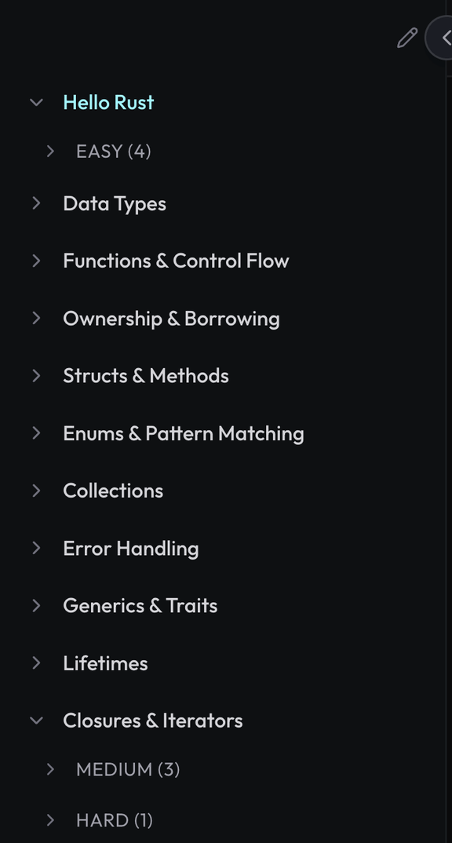

Week 1 - Rust
Part 1 - Rust (Easy)

Slide 5
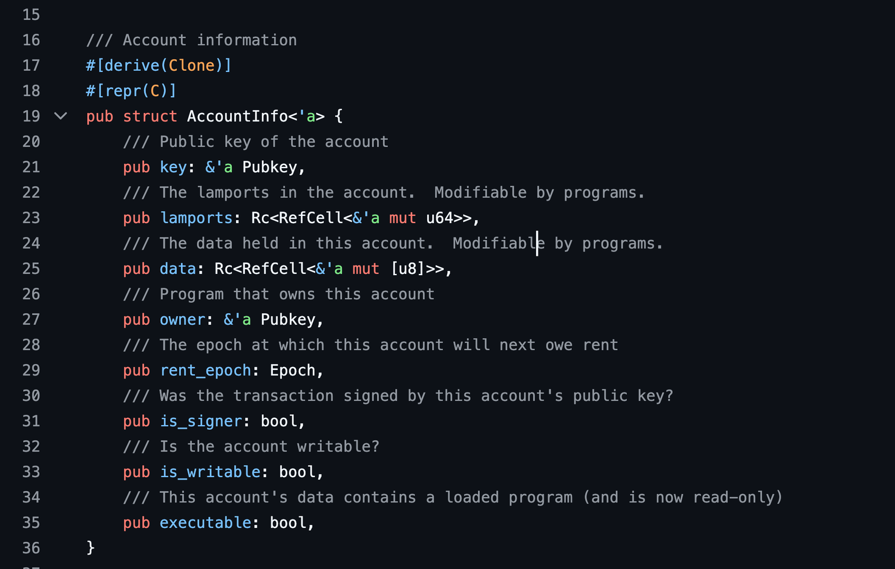
https://github.com/solana-labs/solana/blob/master/sdk/program/src/account_info.rs

Slide 7
https://github.com/solana-labs/solana/blob/master/sdk/program/src/account_info.rs

Slide 8
https://github.com/solana-labs/solana/blob/master/sdk/program/src/account_info.rs

Slide 9
https://github.com/solana-labs/solana/blob/master/sdk/program/src/account_info.rs

Slide 10
https://github.com/solana-labs/solana/blob/master/sdk/program/src/account_info.rs

Slide 11
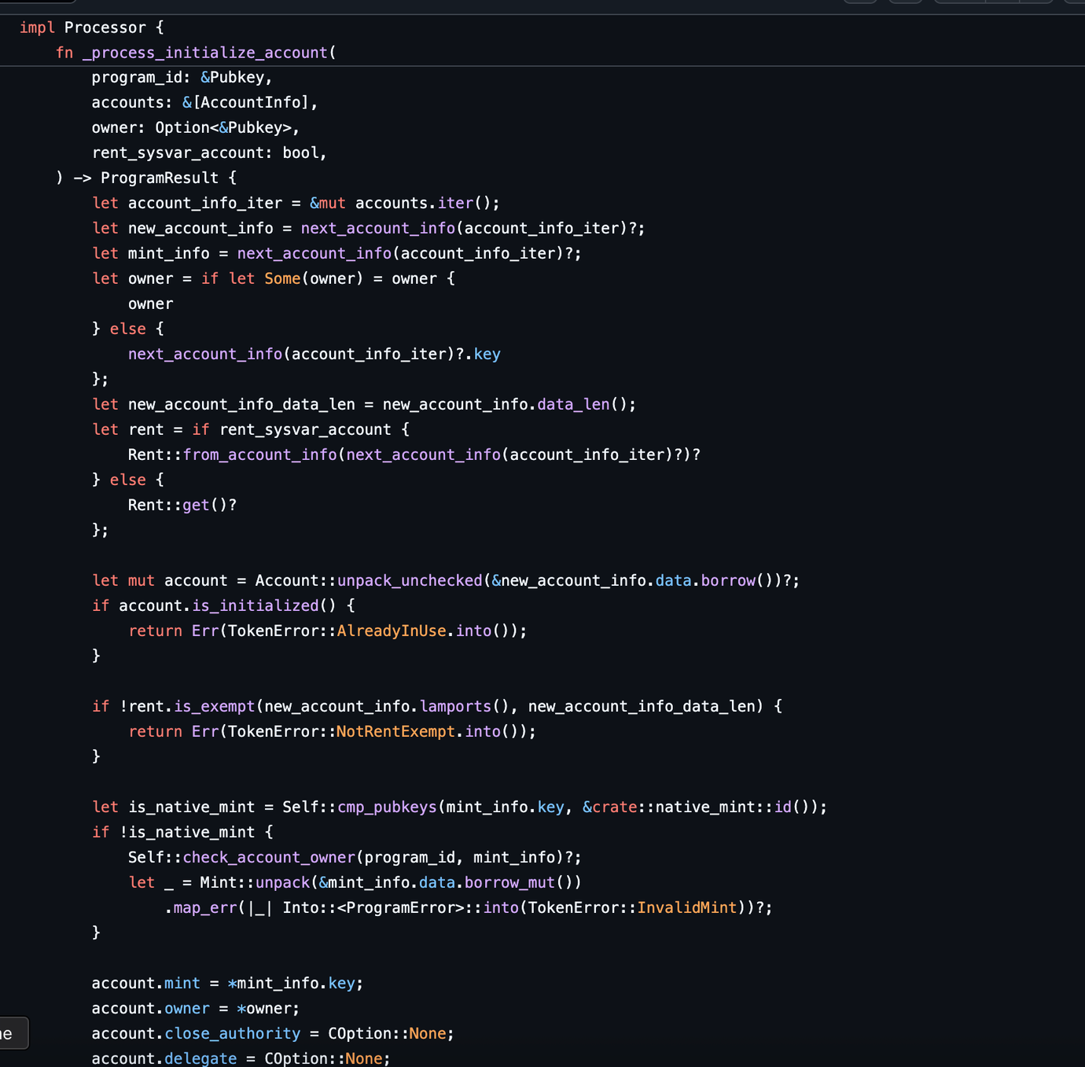
https://github.com/solana-program/token/blob/main/program/src/processor.rs

Slide 12
https://github.com/solana-program/token/blob/main/program/src/processor.rs

Slide 13
https://github.com/solana-program/token/blob/main/program/src/processor.rs

Slide 14
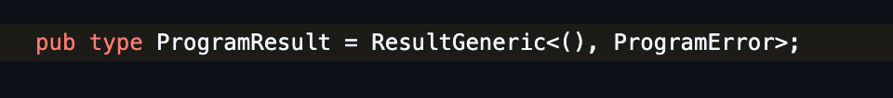
Type aliases
(different from associative types)
https://github.com/solana-program/token/blob/main/program/src/processor.rs

Slide 15
Why &mut reference?
Can I mutate the values inside the arr?
What can I mutate?
https://github.com/solana-program/token/blob/main/program/src/processor.rs

Slide 16
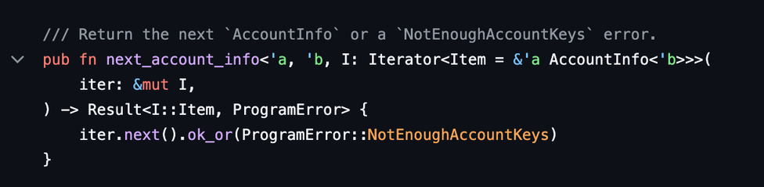
Why &mut reference?
Can I mutate the values inside the arr?
What can I mutate?
https://github.com/rust-lang/rust/blob/main/library/core/src/iter/traits/iterator.rs
https://github.com/solana-program/token/blob/main/program/src/processor.rs

Slide 17
Why &mut reference?
Can I mutate the values inside the arr?
What can I mutate?
https://github.com/rust-lang/rust/blob/main/library/core/src/iter/traits/iterator.rs
https://github.com/solana-program/token/blob/main/program/src/processor.rs

Slide 18
https://github.com/solana-program/token/blob/main/program/src/processor.rs

Slide 19
Old approach
New approach
https://github.com/solana-program/token/blob/main/program/src/processor.rs

Slide 20
https://github.com/solana-program/token/blob/main/program/src/processor.rs

Slide 21
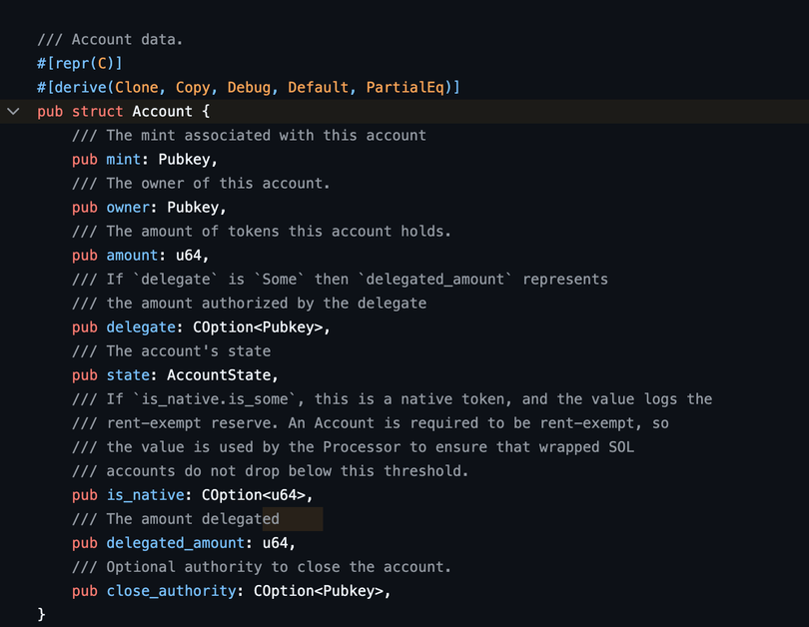
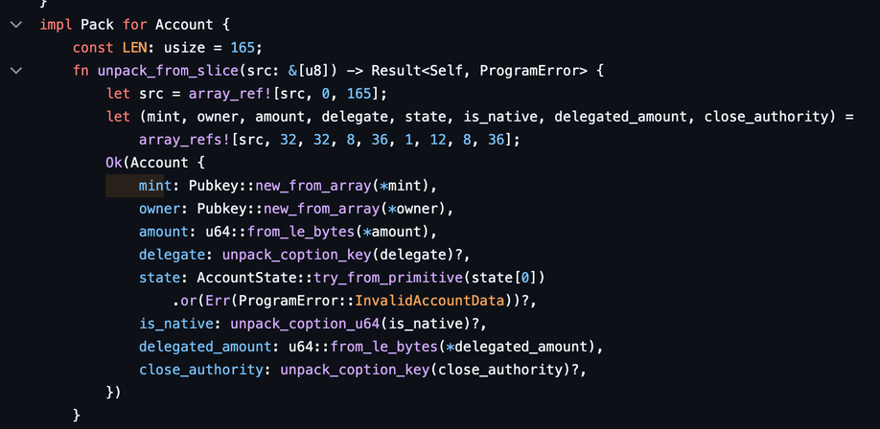
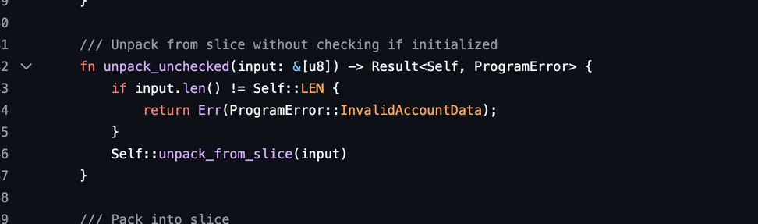
https://github.com/solana-labs/solana/blob/master/sdk/program/src/program_pack.rs
https://github.com/solana-program/token/blob/main/program/src/processor.rs

Slide 22
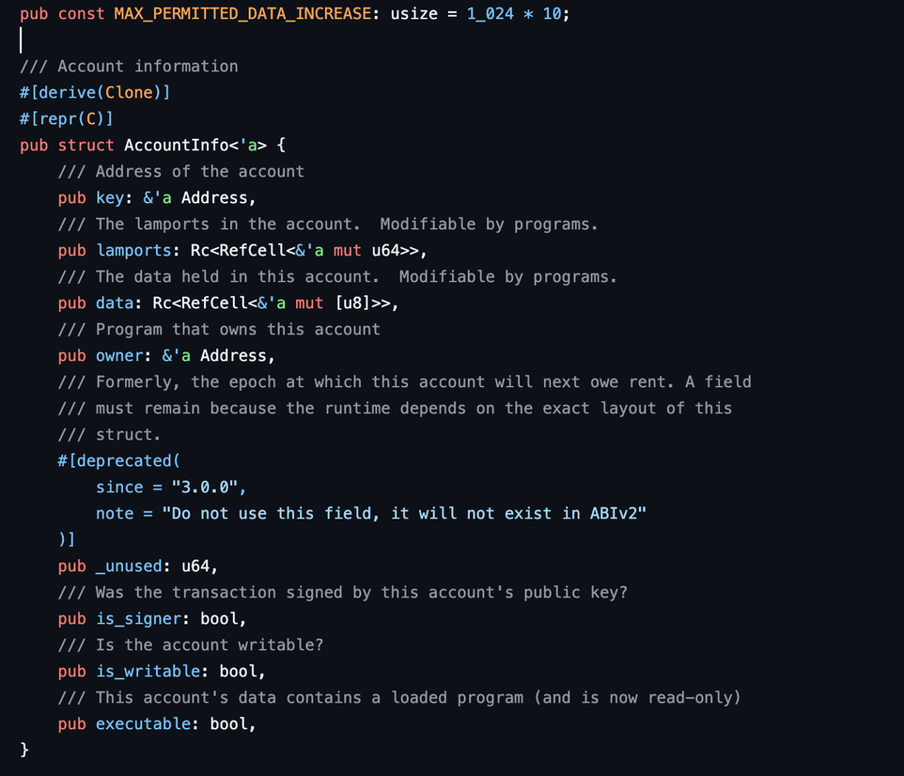
https://github.com/solana-program/token/blob/main/program/src/processor.rs

